Slide 1


Review of the impact of the Sco0sh Schools (Parental Involvement)
Act 2006

Slide 2




The Scottish Schools (Parental Involvement) Act 2006
A legisla>ve framework to support the posi>ve learning and development of children and young people, focused on securing the following outcomes:
Learning at home
Recognising that parents are important educators of children and that learning starts and con>nues at home.
Home school partnerships
Securing the shared responsibili>es of parents, schools and the wider community in working together to educate children
Parental representa3on
Providing a framework in which parents have the opportunity to express their views on their children’s educa>on and have these views taken into considera>on through Parent Forums and representa>on through Parent Councils.

Slide 3
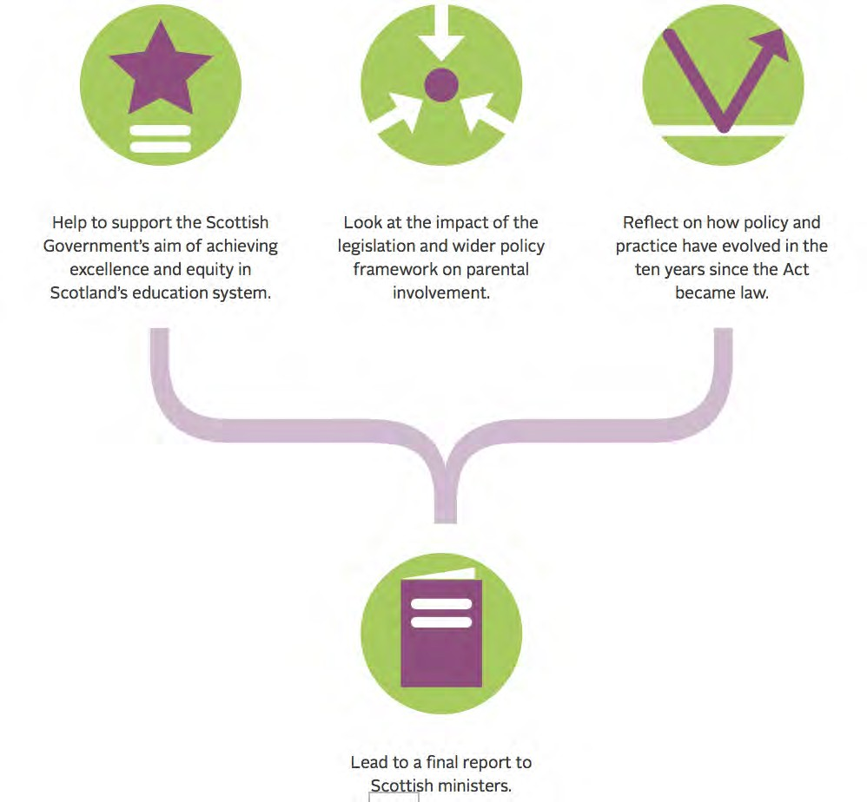
Why conduct a review?
Over ten years since the Parental Involvement Act became law.
Policy and prac>ce have evolved considerably since 2006.
The landscape in Scotland has changed signiﬁcantly across the popula>on, educa>on, pupil numbers and policy frameworks.
Sco0sh ministers requested a review to
inform future policy.

Slide 4

The Review aimed to address the following ques>ons:
What progress have schools and local authori>es made in implemen>ng the 2006 Act?
How have the landscape, prac>ce and approaches to parental involvement evolved since 2006?
How eﬀec>ve are Parent Councils?
To what extent are parents informed by and involved with their
school and engaged in their child’s learning?

Slide 5

Methodology
Independent Research commissioned by Ipsos MORI :
Desk research
Telephone survey of 502 parents across Scotland
Qualita>ve interviews with head teachers, parent councils and other parents
from four case study schools.
NPFS led:
Reference Group
Review of policy
Calls for evidence:
  Over 1200 parent responses
  Over 450 parent council responses
  86 responses from Stakeholders
Head Teacher interviews
Two focus groups

Slide 6
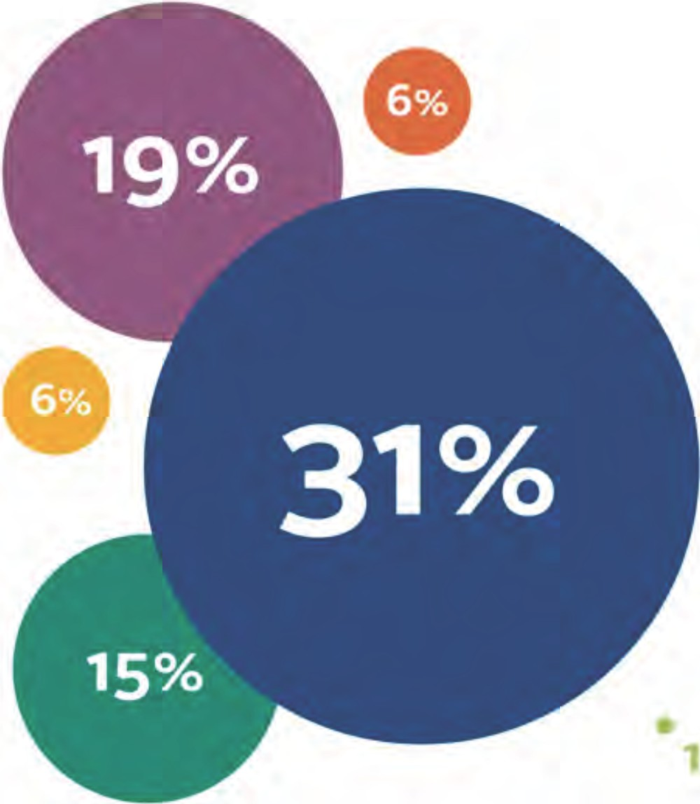
Parents are most likely to feedback to their child's class teacher.
How would you normally feed back to the school about your child's education?
Key:
e
e
Speaking with the class teacher
Speaking with the head teacher
e meetings with your child's teacher
e
Parents' evenings or other one-to-one
Emailing head teacher
Emailing class teacher
Through the parent council
%
the National Parent Forum of Scotland

Slide 7





How comfortable or uncomfortable parents
3 %
6%
4%
are at getting involved with learning
20%
activities and wider activities, at their
child's school
Q. How comfortable or uncomfortab le do you feel about getting involved... with learning activities at your child's schoo l, for example: paired reading, helping in the classroom or with after schoo l clubs/wit h wider school activities , for examp le: helping with sc hool trips or social events, attending schoo l plays or performances?
...learning activities at your child's school
Key:
4 %
35%
11%
7%
2%
V ry Comfortable
Fa·r1y Comfort ble
Neither
0 Fairly uncomfortable
Very uncomfortable
...wider school activities at your childs school
the National Parent Forum of Scotland

Slide 8




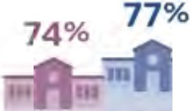




Proportion of parents who have done or
Key:
attended any of the following, by primary/
secondary school
Primary
Q. Within the last sc hool year, have you done any of the follow ing at your c hild's school?
97%
96%
82%
73%
Ill
61%
45%
39%
32%
25%
24%
13%
Ill
7%
n1
Attended a one
Attended school events, such as concerts,plays, sports days
Attended a school fund raising event
Attended a parents' meeting or event about your child's learning
Attended open sessions or afternoons
Helped out at school activities such as trips or school discos
or proms
Attended a parents' social awareness/ information event
Helped out with learning activities
to one meeting
with a teacher to discuss your
child's learning
the National Parent Forum of Scotland

Slide 9
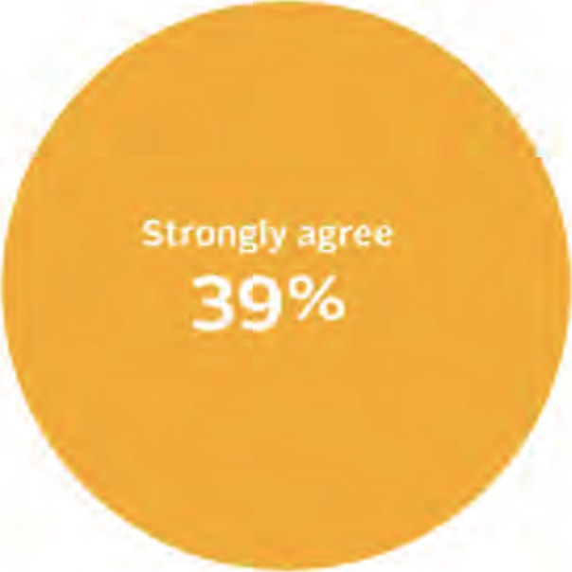
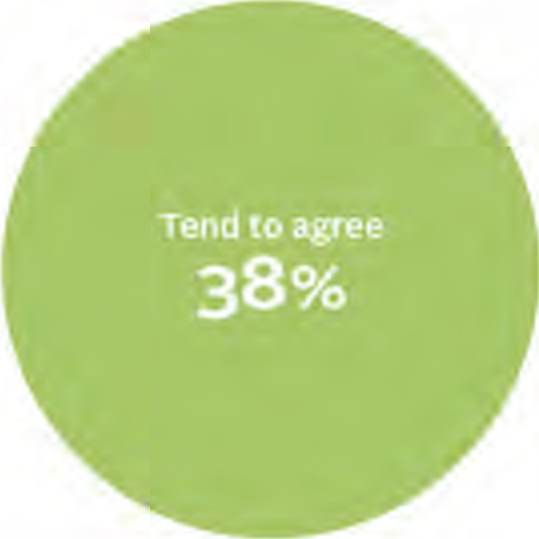

Proportion agreeing/ disagreeing that their child's school take the time consideration of parents into account.
Q. To what extent do you agree or disagree with the following statement?
My child's school takes the time commitments of parents into consideration when staff
organise activities or meetings that parents may be invited to attend.
-
. ·: : .
.
.
the National Parent Forum of Scotland

Slide 10
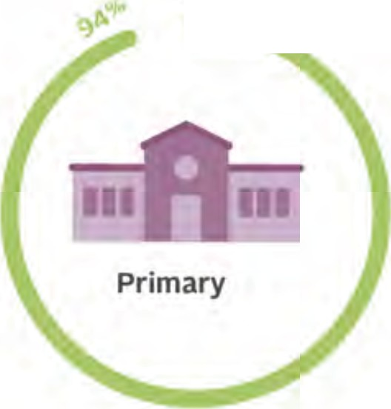


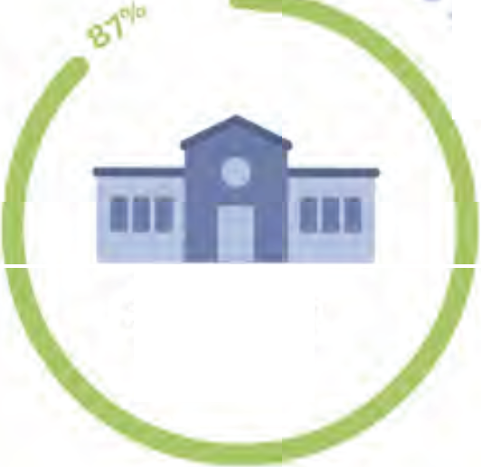

Parents are much more aware of the Parent Council than they are of the Parent Forum
I'm now going to read out some statements. Please tell me to what extent you agree or disagree with each statement.
Is there a Parent Council or similar representative body
Were you aware that there is such a thing as a 'Parent Forum'?
at your child's school?
-<%
-<%
,
Secondary
Key:
Yes
No - Don't Know
the National Parent Forum of Scotland

Slide 11








What parents think the Parent Council does at their child's school
1.
2.
Q. Wh ich if any of the follow ing does the Parent Council at your child's school do?
8%
3.
4.
Key:
7%
30%
Don't Know
No - Yes
i. Fundraises for the school
5.
6.
2. Tells the school management team when parents have concerns
3. Helps to develop the School Improvement Plan
29%
Asks parents for their views on how the school is run
Asks parents' views about what the children in the school are learning
Provides information about education and learning to parents
Helps with the recruitment of senior staff members,for example:the head teacher
7.
8.
8. Helps to develop the school handbook
19%
14%
the National Parent Forum of Scotland

Slide 12
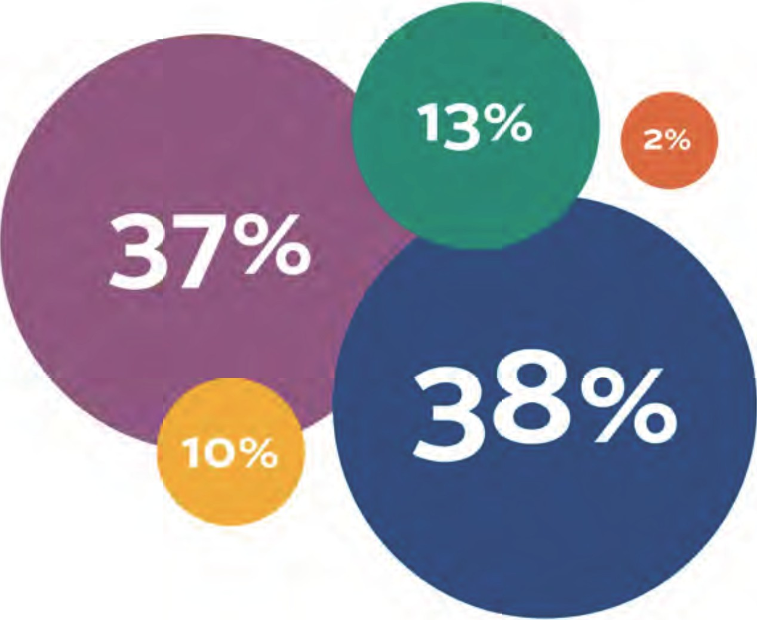
The majority think that the Parent Council is valued by the school's Senior Management Team
To what extent, if at all, do you think
the views and suggestions of the Parent Council are valued by the school's senior
management team?
Key:
•To a great extent
To some extent
Just a little
•
Not at all
Don't know
the National Parent Forum of Scotland

Slide 13
The conclusions… (1)
Conclusions of the Review include the following:
There is a desire to update and improve key aspects of the Act, and to revise the accompanying guidance.
Increased support for parental engagement in the early years is required, as the legisla>on does not extend to children accessing government-­‐funded early-­‐ learning and childcare.
There was no desire for statutory decision-­‐making powers to be assigned to Parent Councils, and no desire for a return to the previous School Board arrangements.
There is a need to clarify current statutory du>es on head teachers for involving parents in the life of the school life, and for greater collabora>on with Parent
Councils to ensure eﬀec>ve consulta>on.

Slide 14
The conclusions… (2)
Although there have been major improvements in teachers’ communica>on and working with parents, important challenges remain among some teachers for apprecia>ng the role and contribu>on of parents
Financial support to Parent Councils must be protected to enable them to fulﬁl their role and func>on under the Act. Inconsistencies in ﬁnancial and other support provided by local authori>es to Parent Councils should be addressed.
Although many Parent Councils were unaware of any responsibili>es placed on them and local authori>es for equali>es and diversity, many recognised a lack of diversity and would welcome new strategies to address this. (The Review report has documented criteria for the most eﬀec>ve parent councils.)
Further work is required on the ‘learning at home’ strand of the Parental Act, due to concerns that priority has been given to implemen>ng the home/school
partnerships and parental representa>on at the expense of learning at home.

Slide 15

The recommendations…
The Review has made a total of 38 recommenda>ons to Sco0sh Government, na>onal agencies, local authori>es and schools.
The Na>onal Parent Forum of Scotland will publish a joint interim progress report with the Sco0sh Government and the Associa>on of Directors of Educa>on in Scotland and relevant stakeholders by the end of 2018, followed by a joint full progress report, published by the end of 2019.

Slide 16











Thank you…
Parents & Carers
Teachers
Head teachers
Educa1on stakeholders
Sco7sh Parental Involvement Oﬃcers Network

